Slide 1
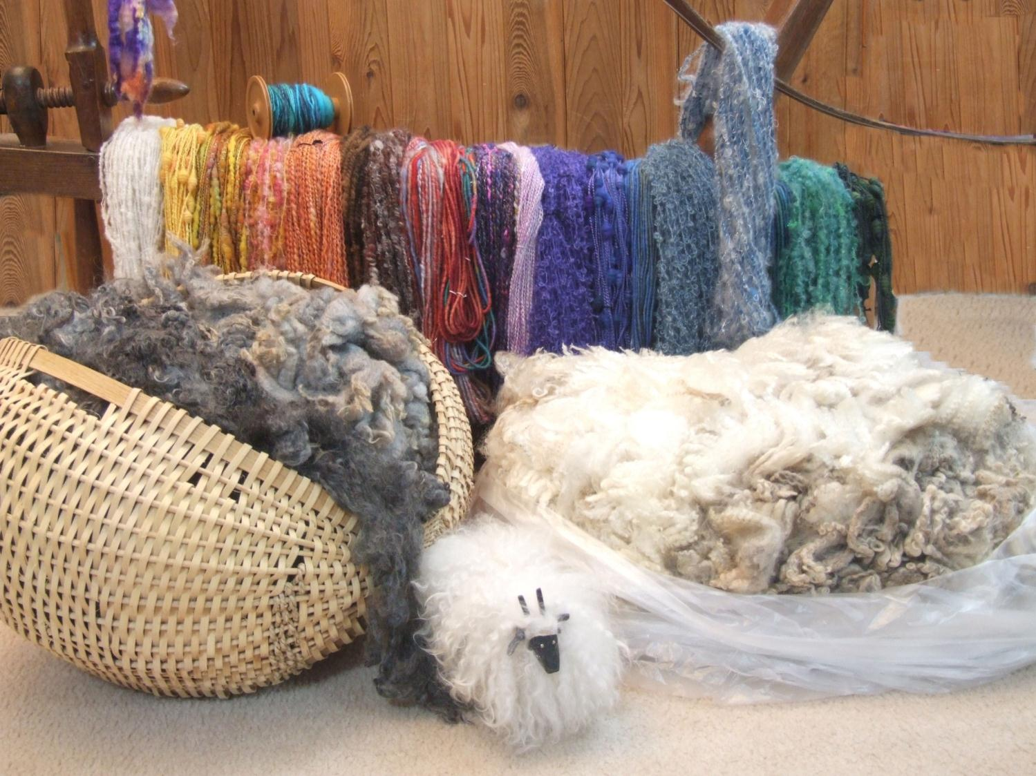
The Dance of Color and Texture in Spinning
Peggy Doney

Slide 2
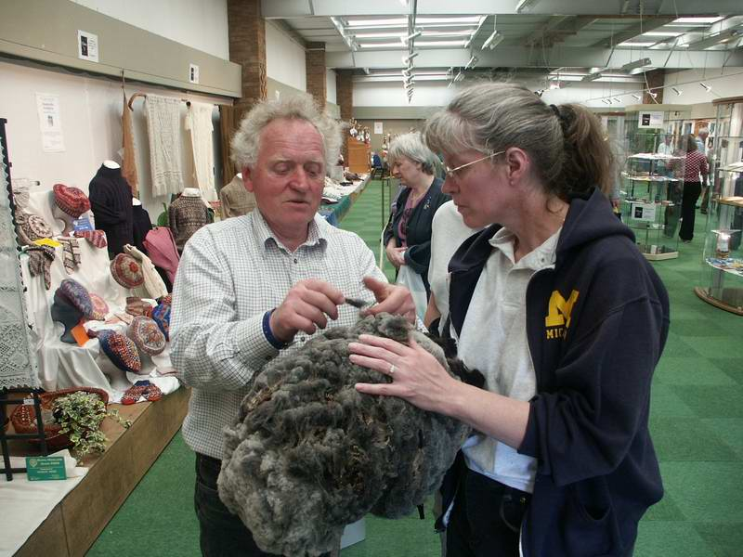
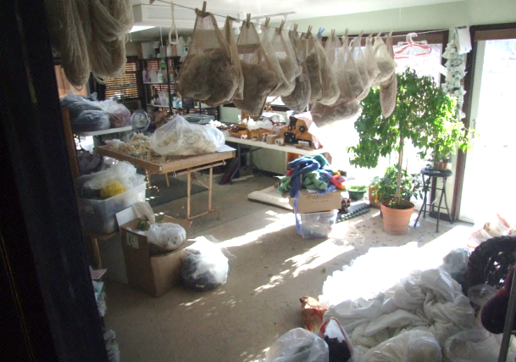
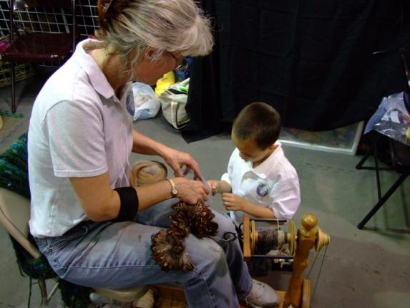
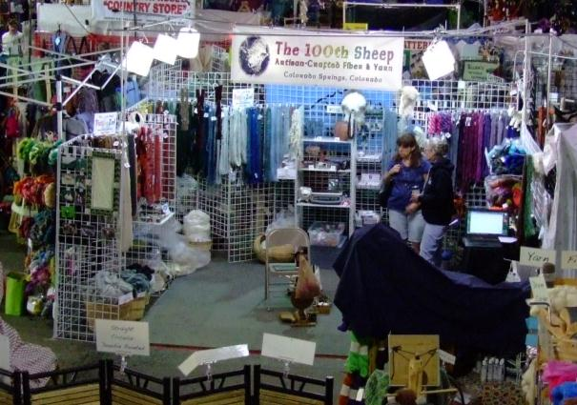
How Did I End Up Here?

Slide 3
How Did I End Up Here?

Slide 4
How Did I End Up Here?

Slide 5
How Did I End Up Here?

Slide 6
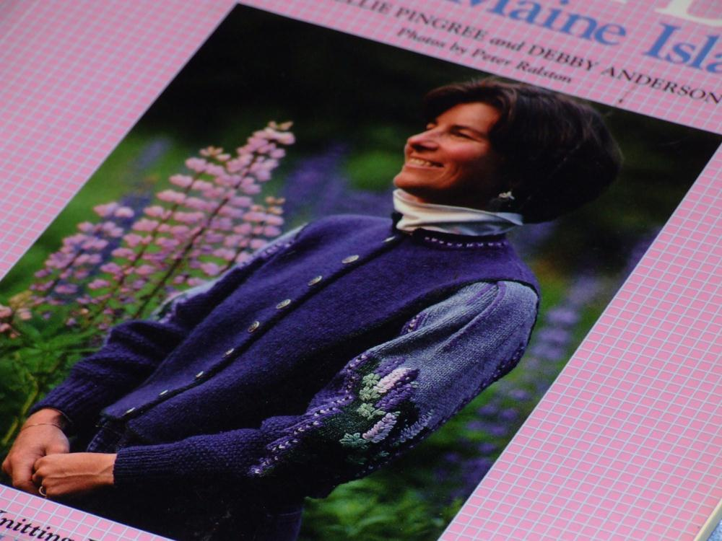
What Drives Me to Spin
Creativity
Given Fiber
Enjoyment
Unique
Cost
Texture
Necessity

Slide 7
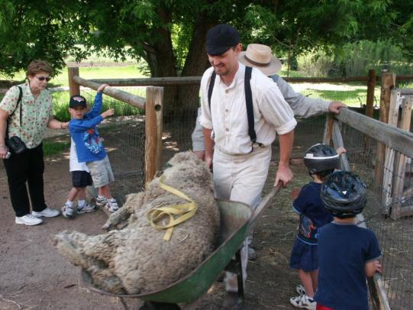
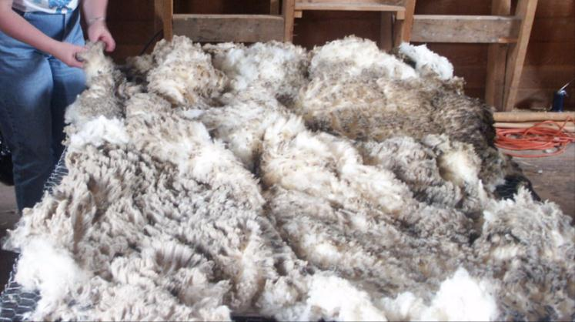
Availability of Fleeces/Fibers/Manufactured
Raw Fleeces

Slide 8
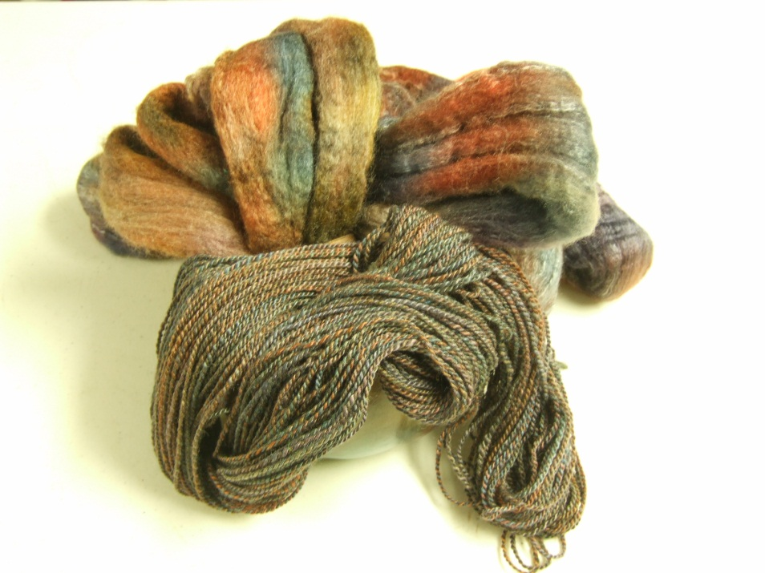
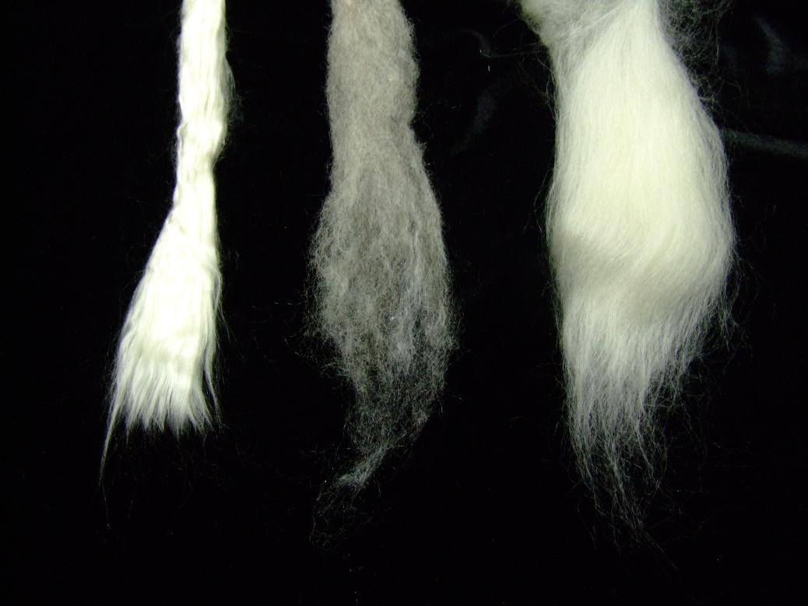
Availability of Fleeces/Fibers/Manufactured
Raw Fleeces
Rovings - Top

Slide 9
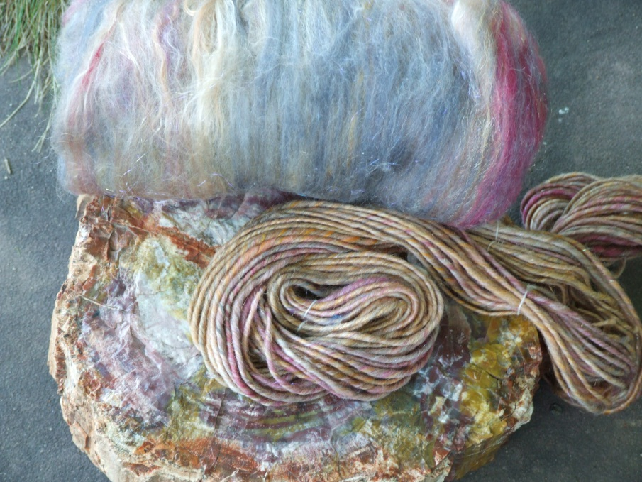
Availability of Fleeces/Fibers/Manufactured
Raw Fleeces
Rovings - Top
Batts

Slide 10
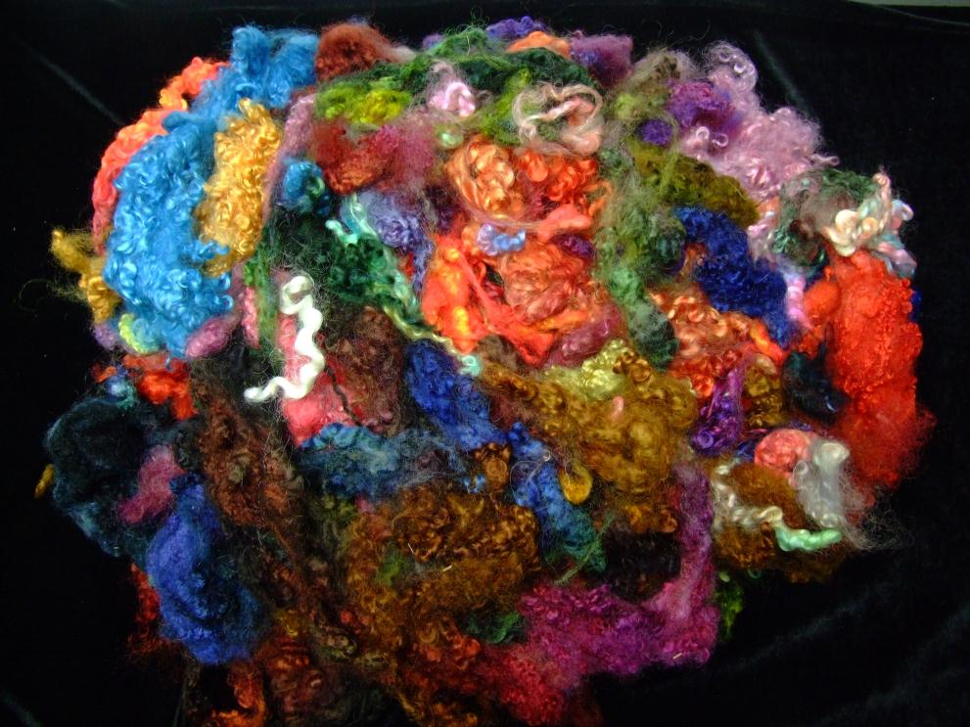
Availability of Fleeces/Fibers/Manufactured
Raw Fleeces
Rovings - Top
Batts
Locks

Slide 11
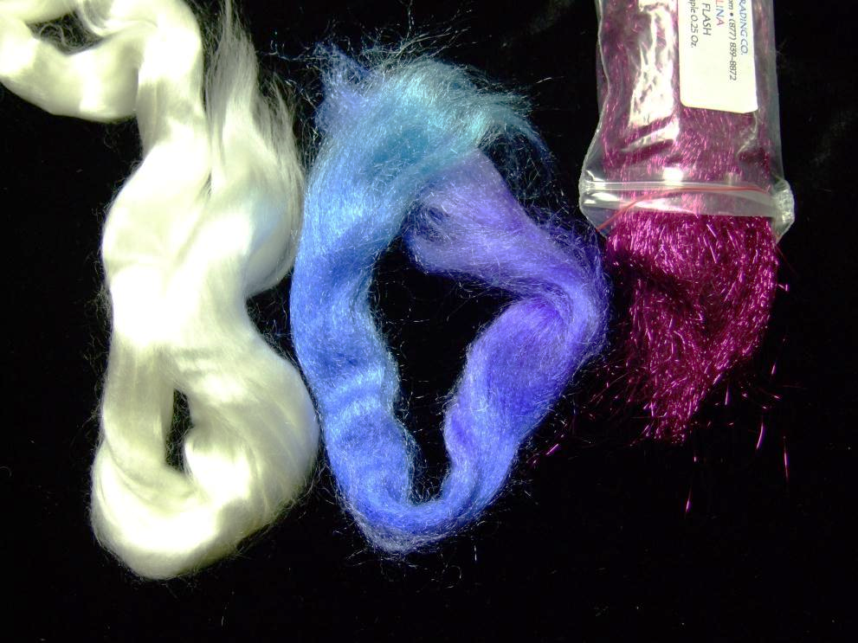
Availability of Fleeces/Fibers/Manufactured
Raw Fleeces
Rovings - Top
Batts
Locks
Manufactured
Tencel Firestar Angelina

Slide 12
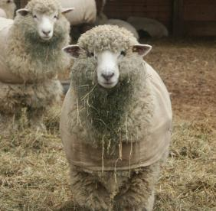
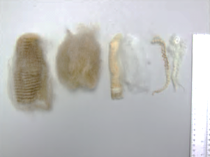
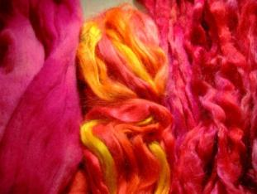
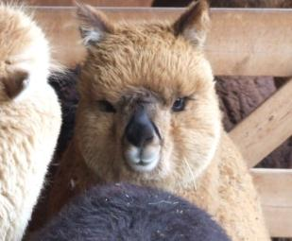
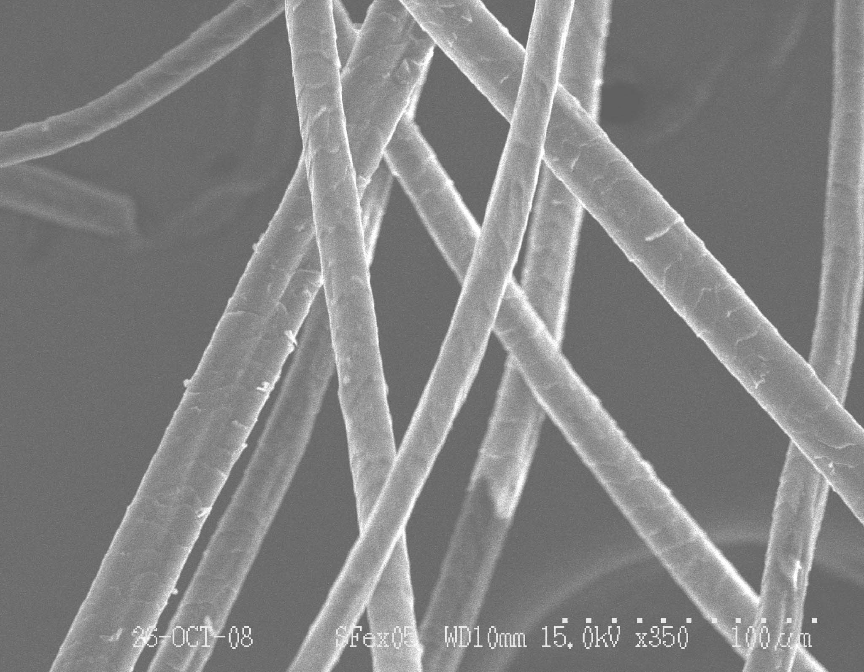
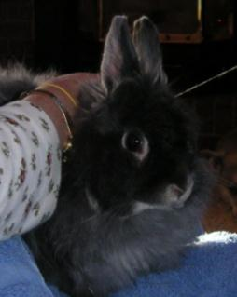
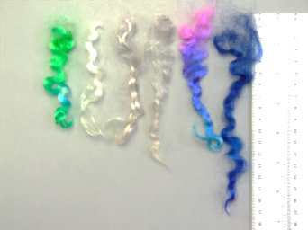
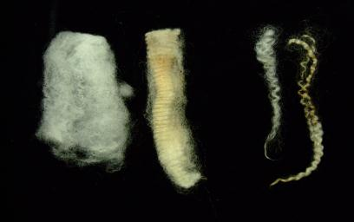
Fleece Characteristics
Crimp
Luster
Fineness
Lock Length
Lock Structure
Washed vs. unwashed
Soundness
Allergy
Color
Cleanliness

Slide 13
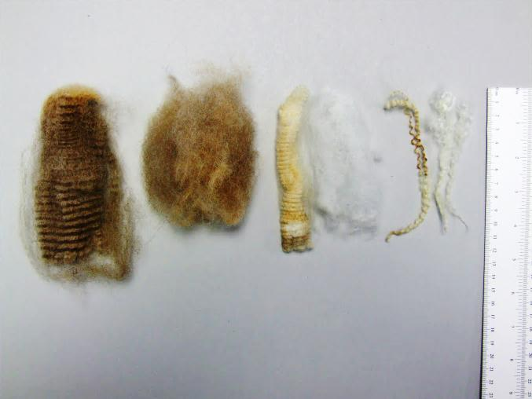
Fleece Characteristics
Crimp

Slide 14
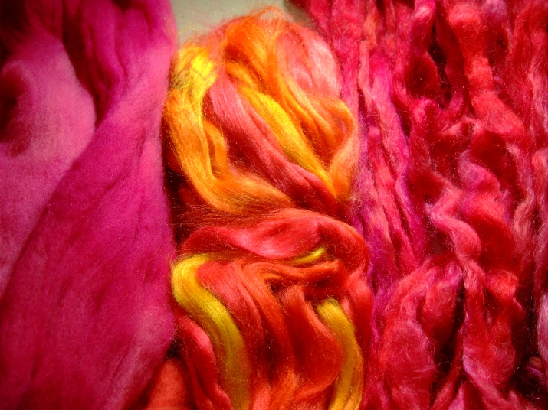
Fleece Characteristics
Luster

Slide 15
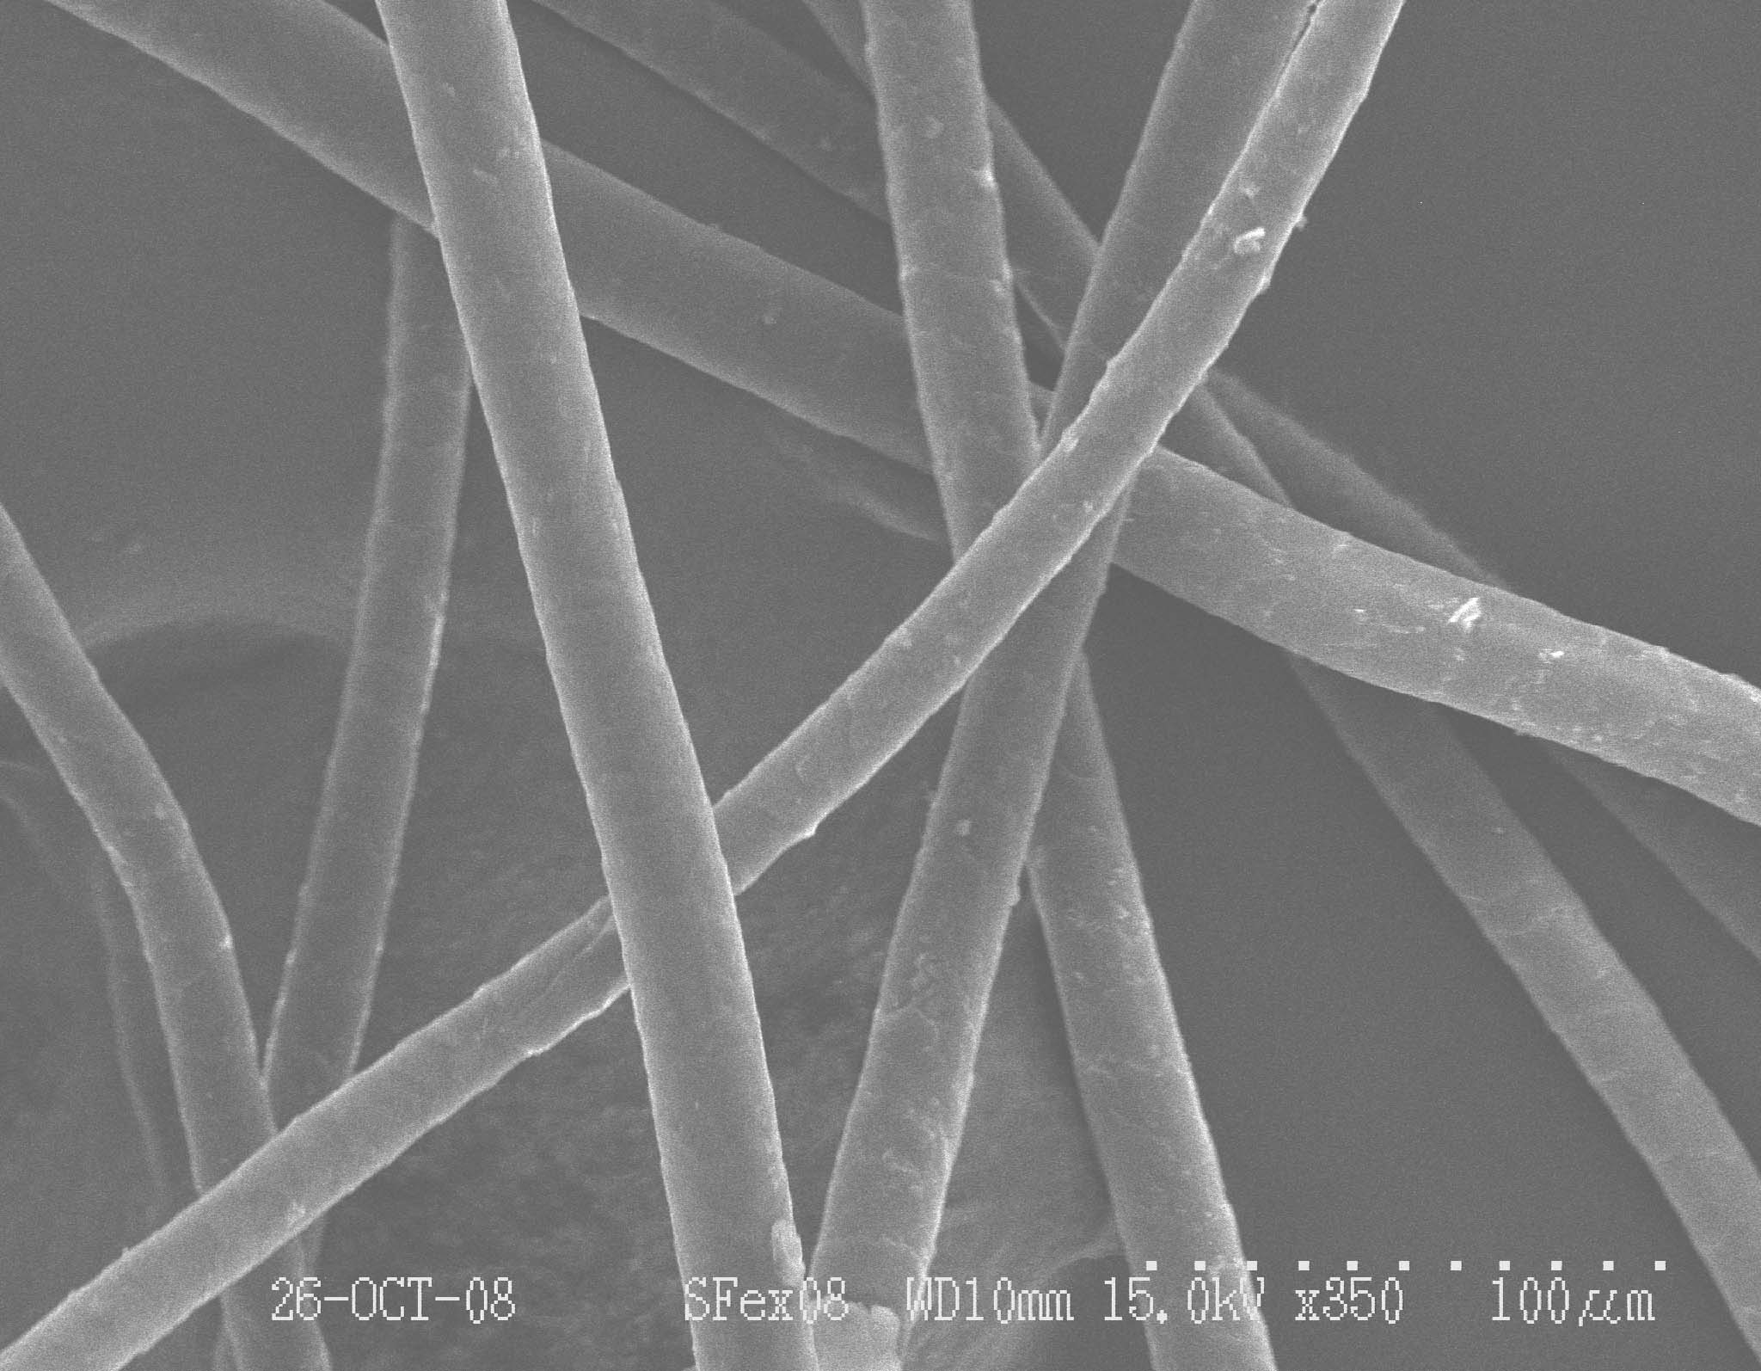
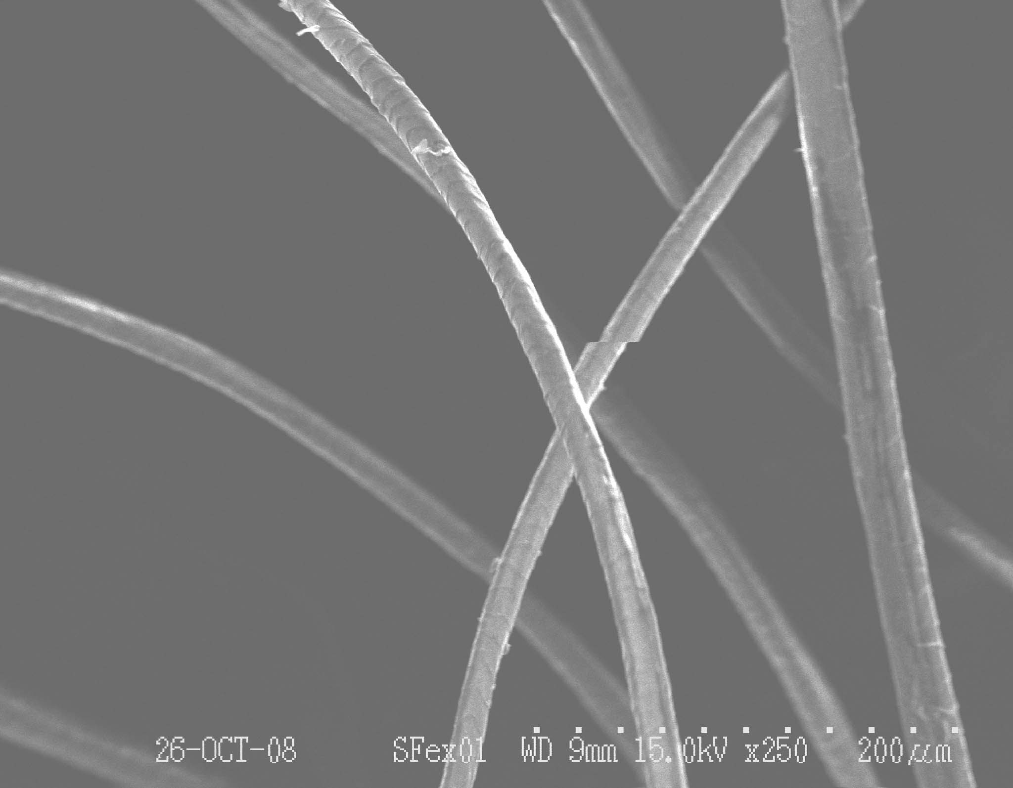
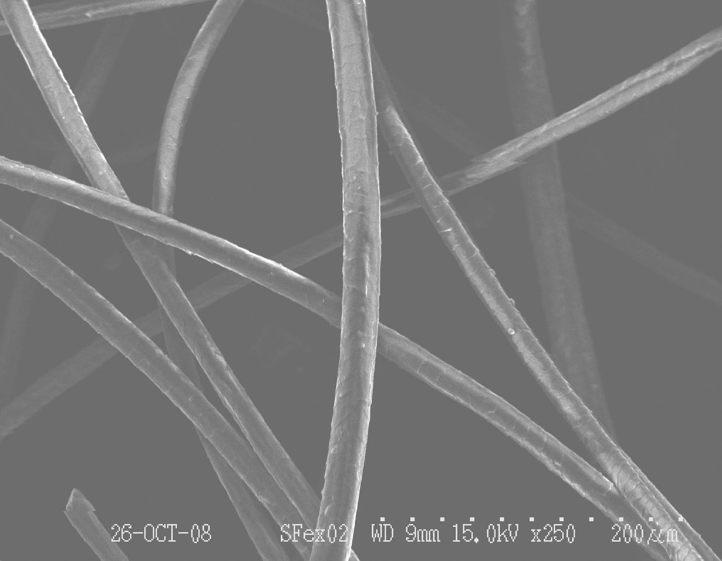
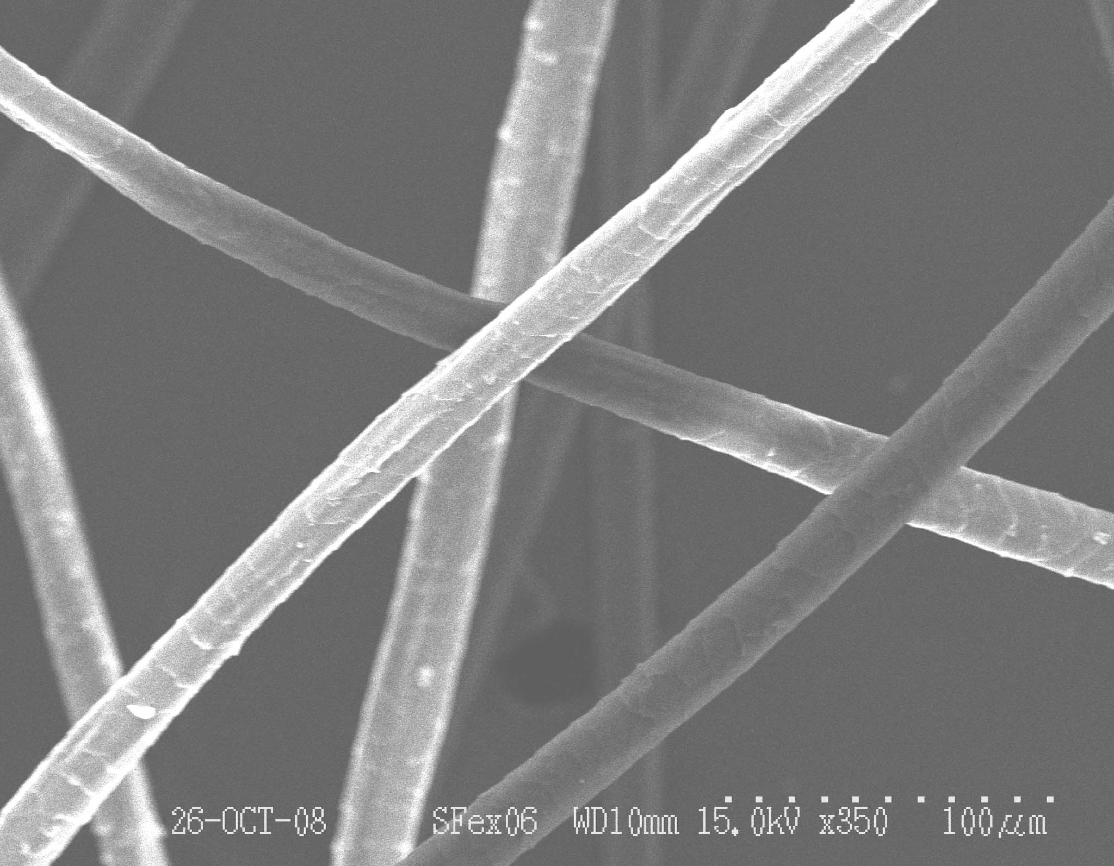
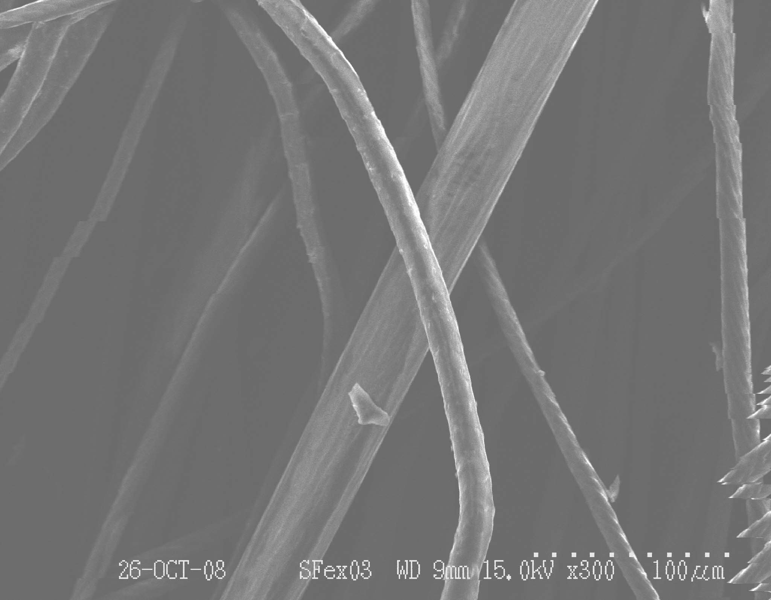
Fleece Characteristics
Fineness
Coarse Wool - 350x
Alpaca – Cria - 350x
Alpaca – Cria - 250x
Angora - 250x
Angora - 250x
Baby Yak - 300x

Slide 16
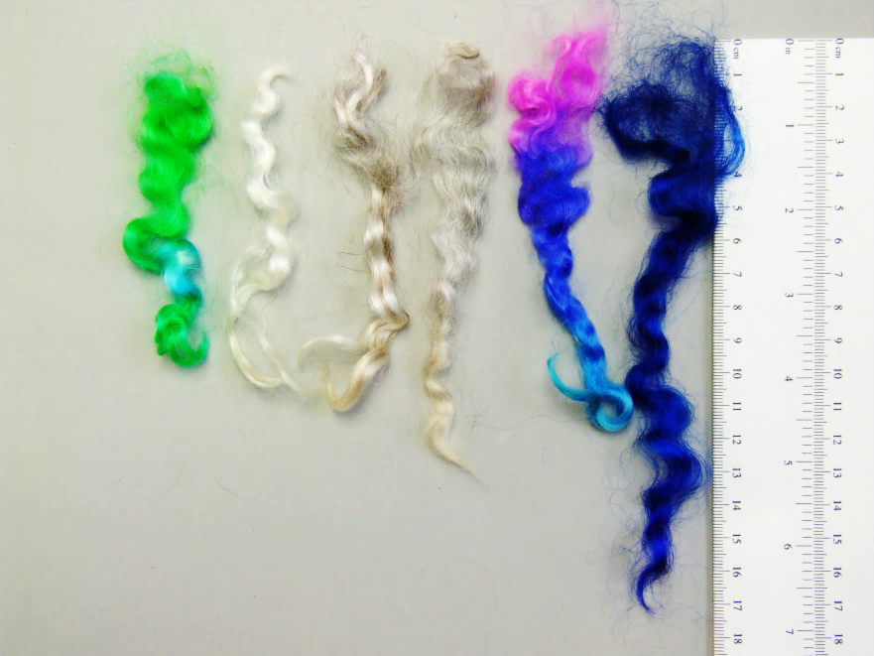
Fleece Characteristics
Lock Length

Slide 17

Fleece Characteristics
Lock Structure

Slide 18
Fleece Characteristics
Washed vs. unwashed

Slide 19
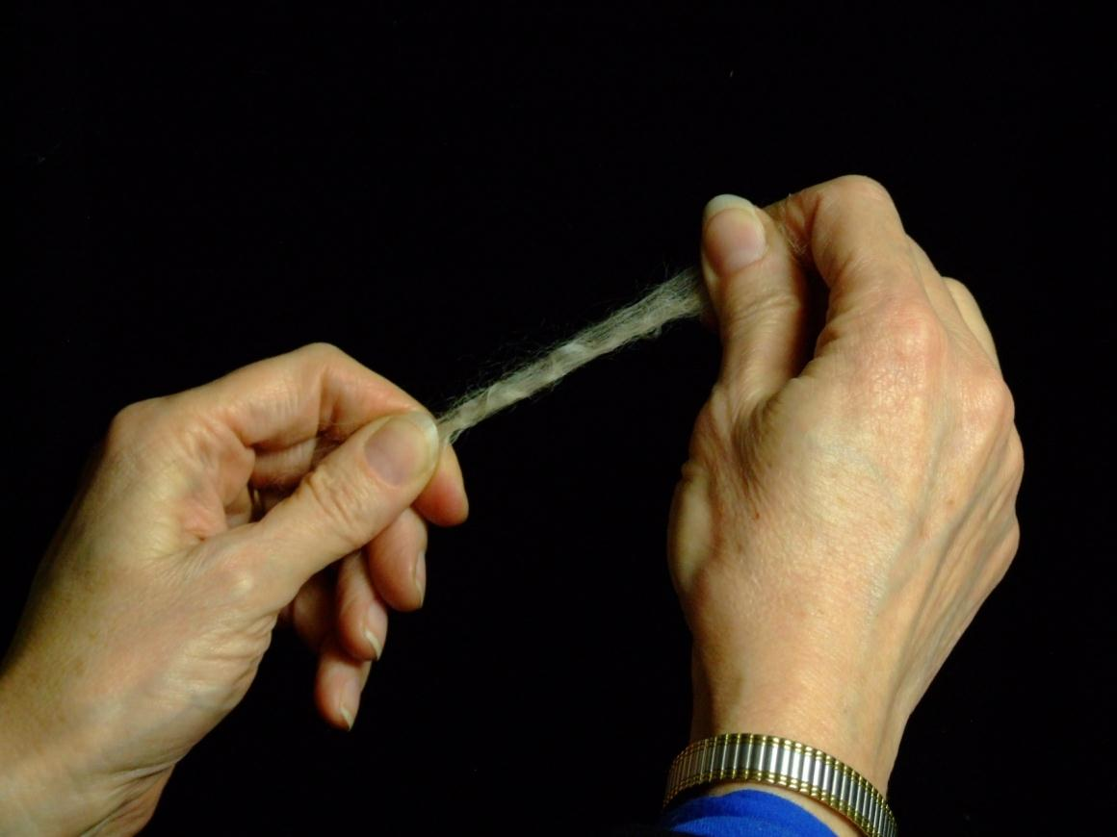
Fleece Characteristics
Soundness

Slide 20
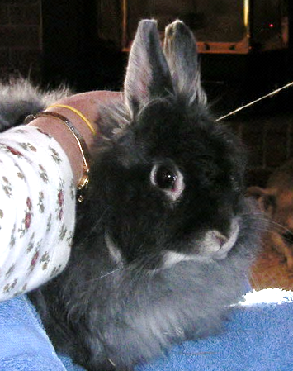
Fleece Characteristics
Allergy

Slide 21
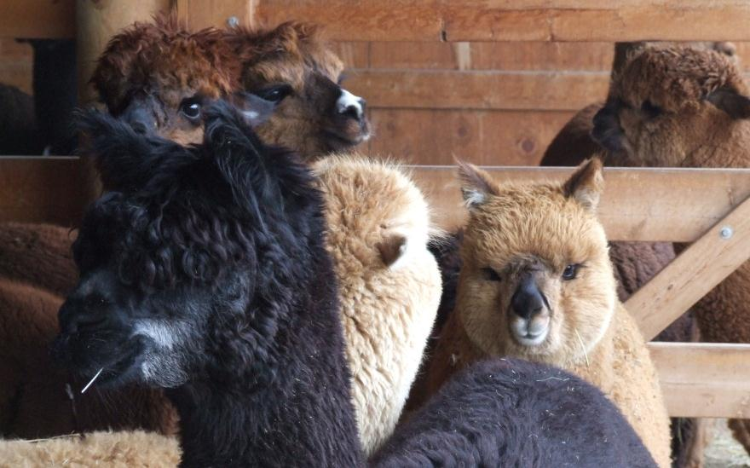
Fleece Characteristics
Color

Slide 22
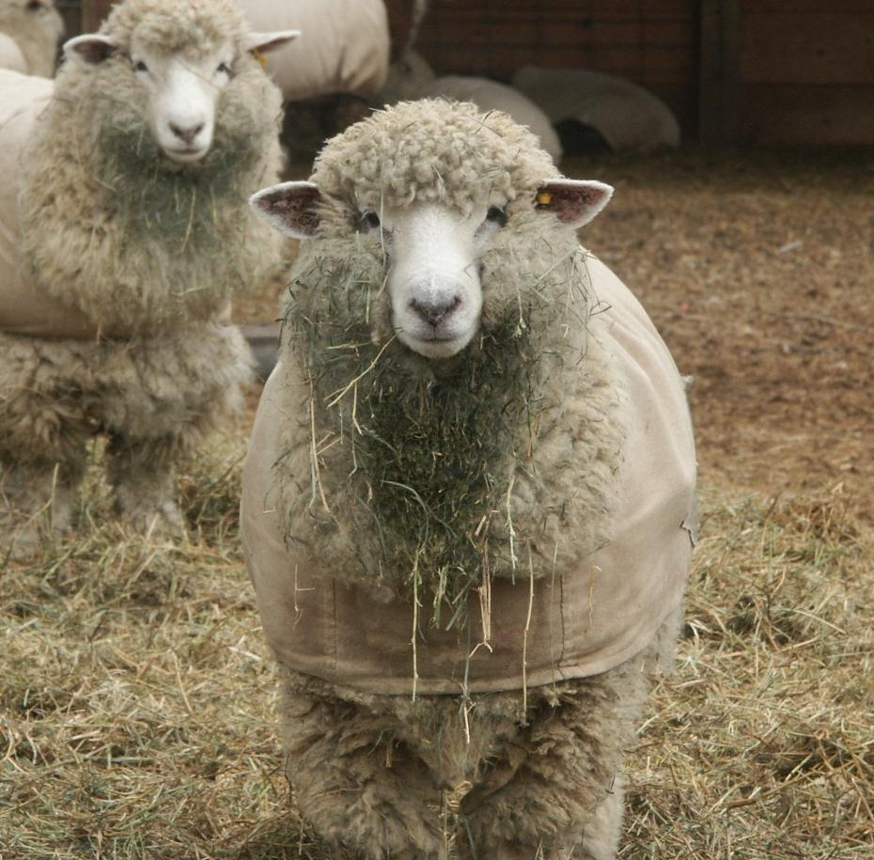
Fleece Characteristics
Cleanliness

Slide 23
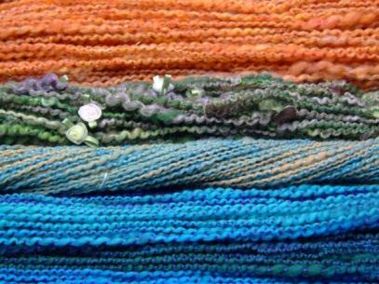
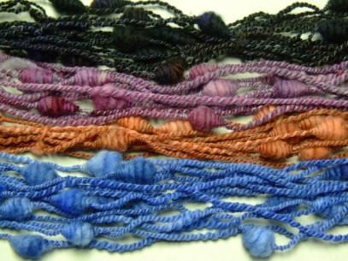
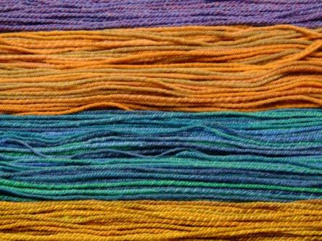
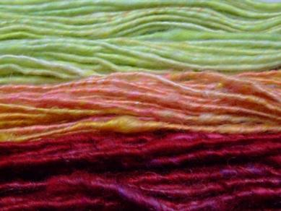
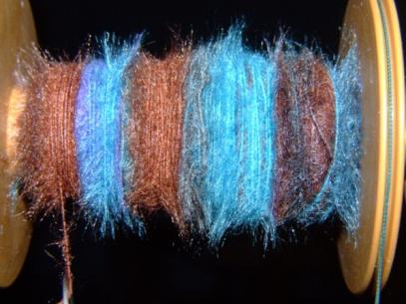
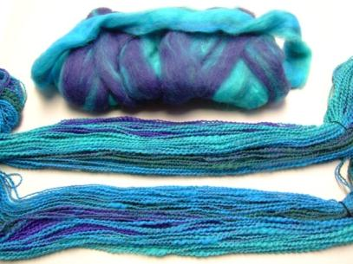
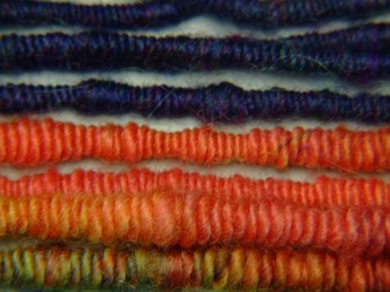
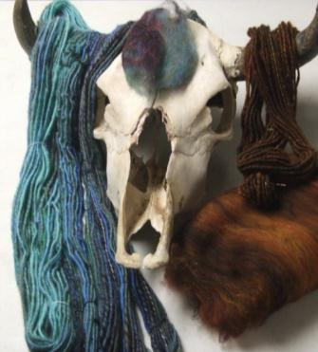
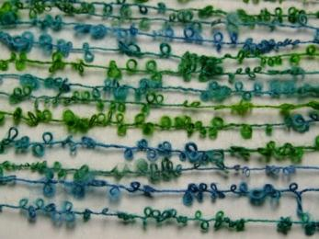
Keeping Colors Intact

Slide 24

Keeping Colors Intact

Slide 25
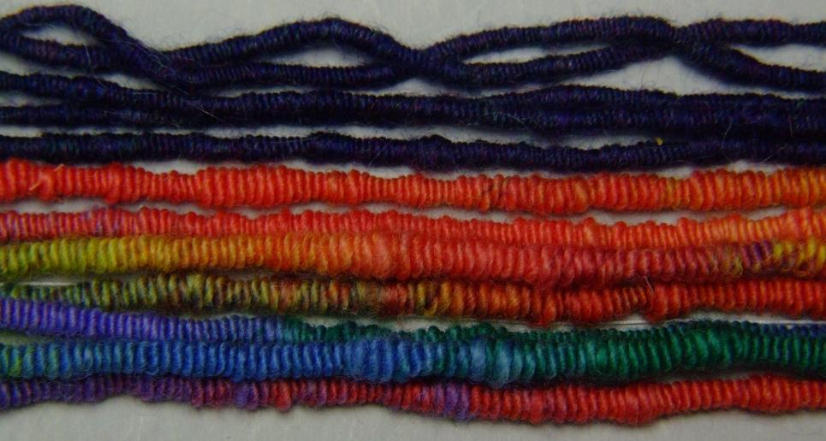
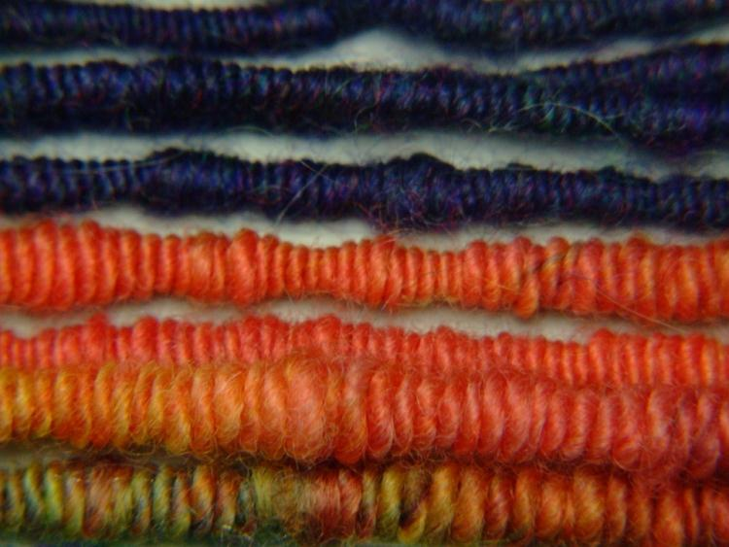
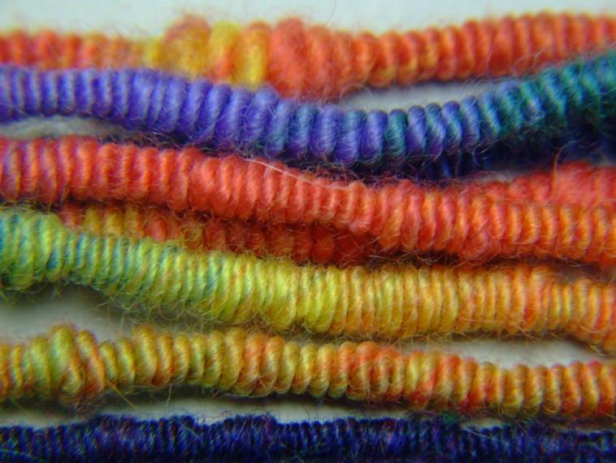
Keeping Colors Intact

Slide 26
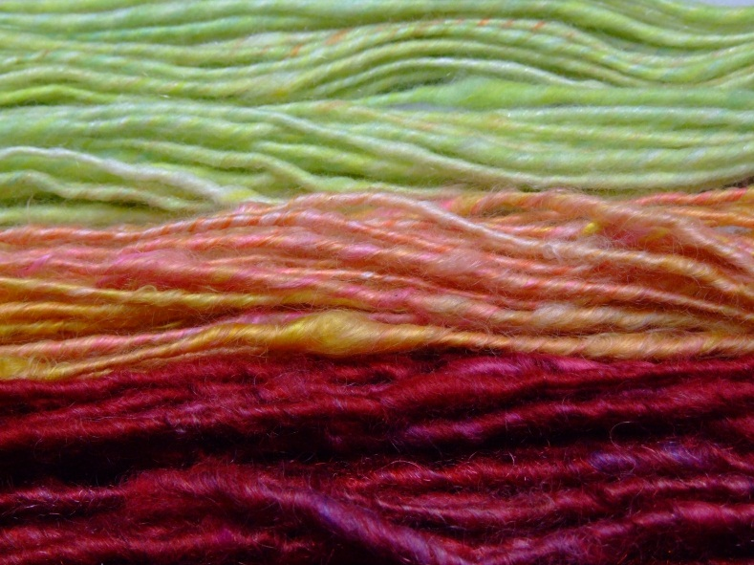
Keeping Colors Intact

Slide 27
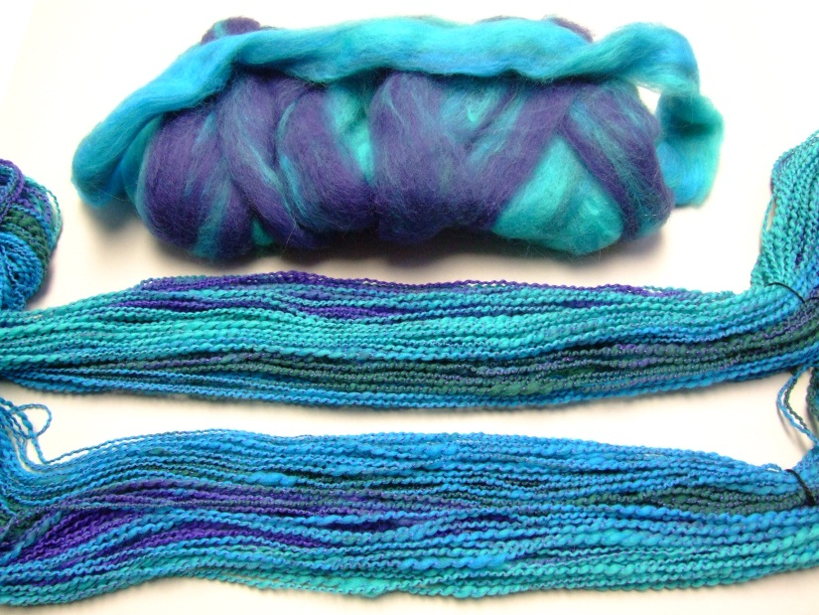
Keeping Colors Intact

Slide 28

Keeping Colors Intact

Slide 29
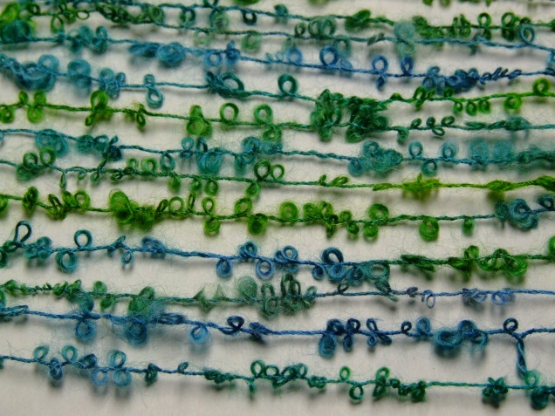
Keeping Colors Intact

Slide 30

Keeping Colors Intact

Slide 31
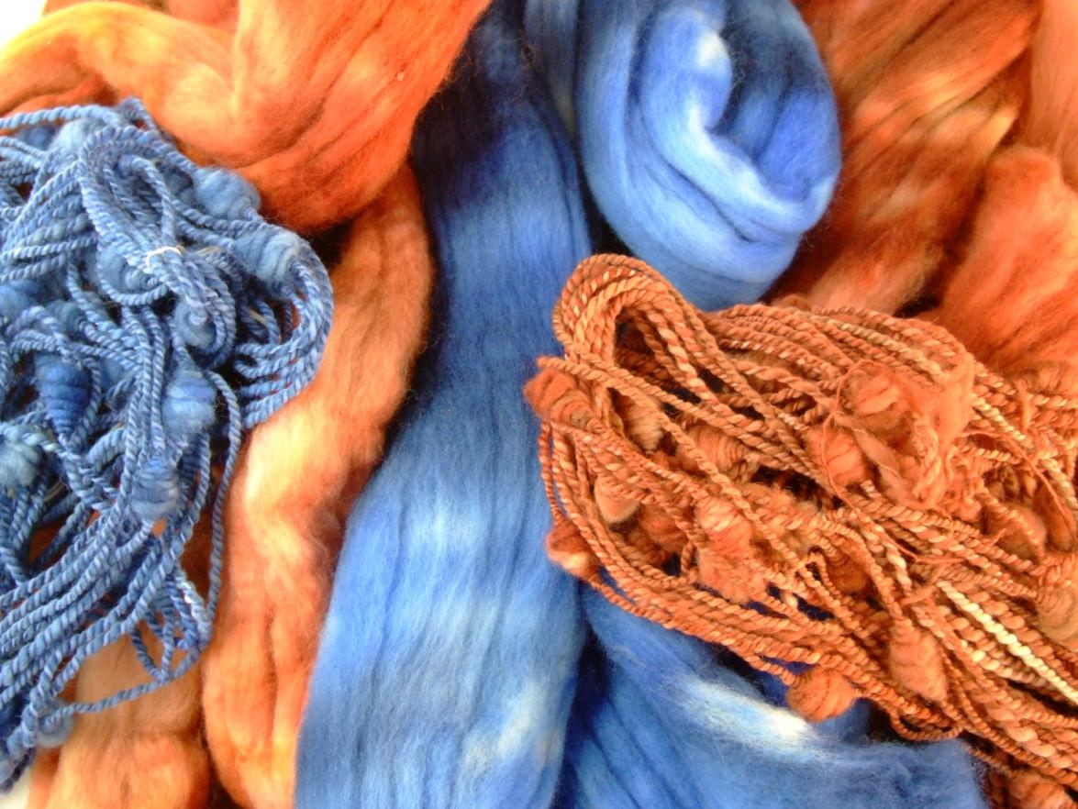
Keeping Colors Intact

Slide 32

Keeping Colors Intact

Slide 33
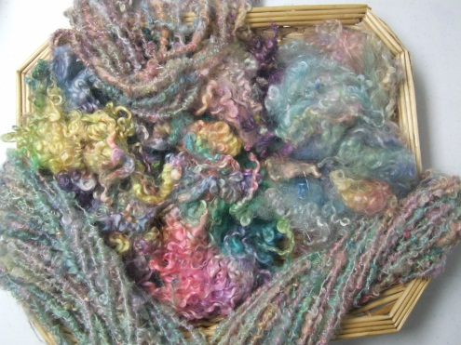



Letting Colors Play

Slide 34

Letting Colors Play

Slide 35


Letting Colors Play

Slide 36

Letting Colors Play

Slide 37

Letting Colors Play

Slide 38




Plies

Slide 39
Plies

Slide 40
Plies

Slide 41
Plies

Slide 42

Plies

Slide 43

Plies

Slide 44









Bouclé!

Slide 45

Bouclé!

Slide 46

Bouclé!

Slide 47

Bouclé!

Slide 48

Bouclé!

Slide 49

Bouclé!

Slide 50

Bouclé!

Slide 51

Bouclé!

Slide 52

Bouclé!

Slide 53

Bouclé!

Slide 54

Bouclé!

Slide 55


Bouclé!

Slide 56








Inclusions

Slide 57

Inclusions

Slide 58

Inclusions

Slide 59

Inclusions

Slide 60

Inclusions

Slide 61

Inclusions

Slide 62


Inclusions

Slide 63









Choreography

Slide 64

Choreography

Slide 65


Choreography

Slide 66

Choreography

Slide 67


Choreography

Slide 68

Choreography

Slide 69


Choreography

Slide 70

Choreography

Slide 71


Choreography

Slide 72


Choreography

